Slide 1

COLLECTION LIBRARY AND CONTEXT MANAGER IN PYTHON
Name: DEBPARNA BISWAS Roll:21CH10022 IIT KHARAGPUR 1ST YEAR UG

Slide 2
CONTEXT MANAGER
Context managers are used for basically handling the setup and release of resources like files, databases, etc. in an efficient way.
This is important because if say some file or database is opened, and something goes wrong or say we need to release the resource after having worked with it, and we do not do so there can be fatal consequences. The system might end up crashing or slowing down or there can be memory leak.
We want to avoid these issues and so Context managers come about to be very handy tools.

Slide 3
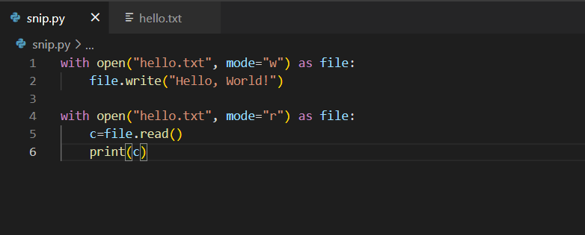
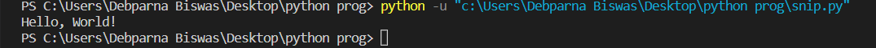

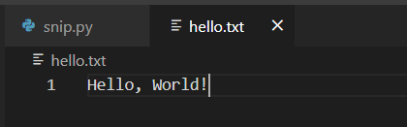
The ‘with’ statement
There are some existing context managers in python that can be used by the ‘with’ statements for file handling purposes. If we want to manage a file with the in-built context managers we can do so in the following way:
BEFORE
AFTER

Slide 4
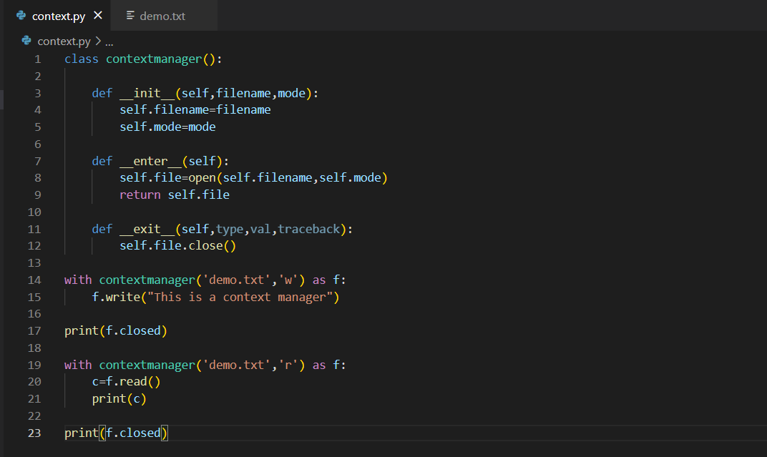
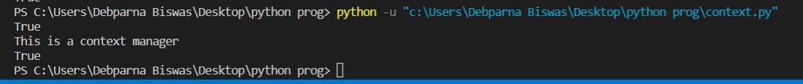
Creating Context Manager

Slide 5
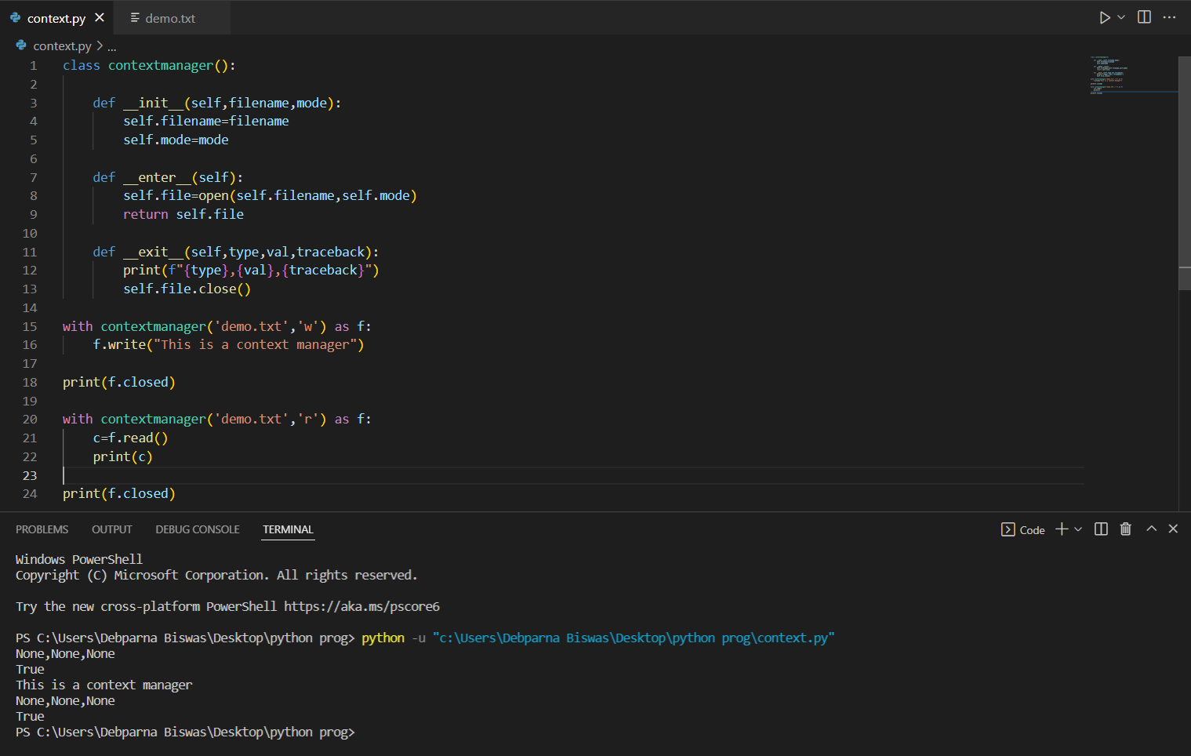
Checking for Exception

Slide 6
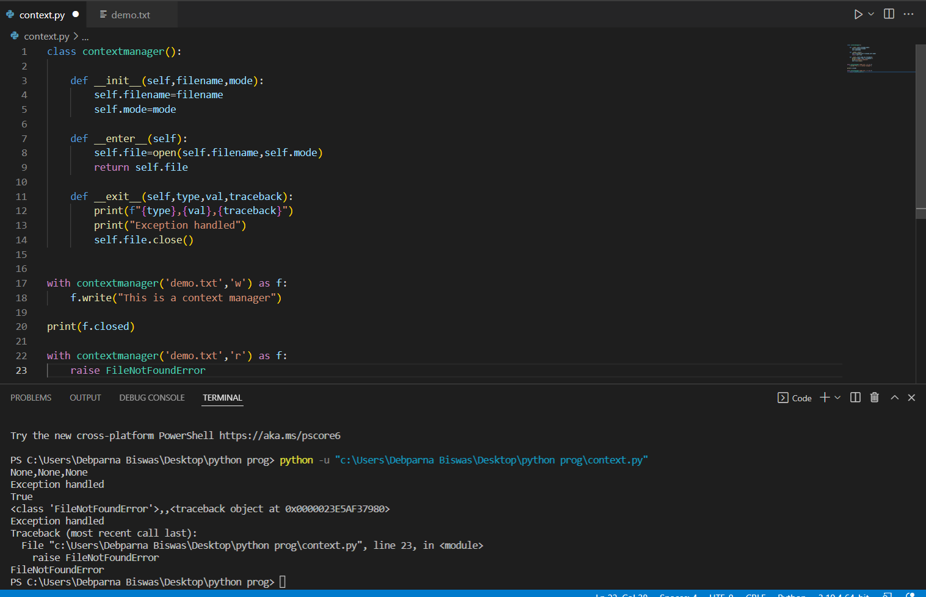
Raising an Exception

Slide 7
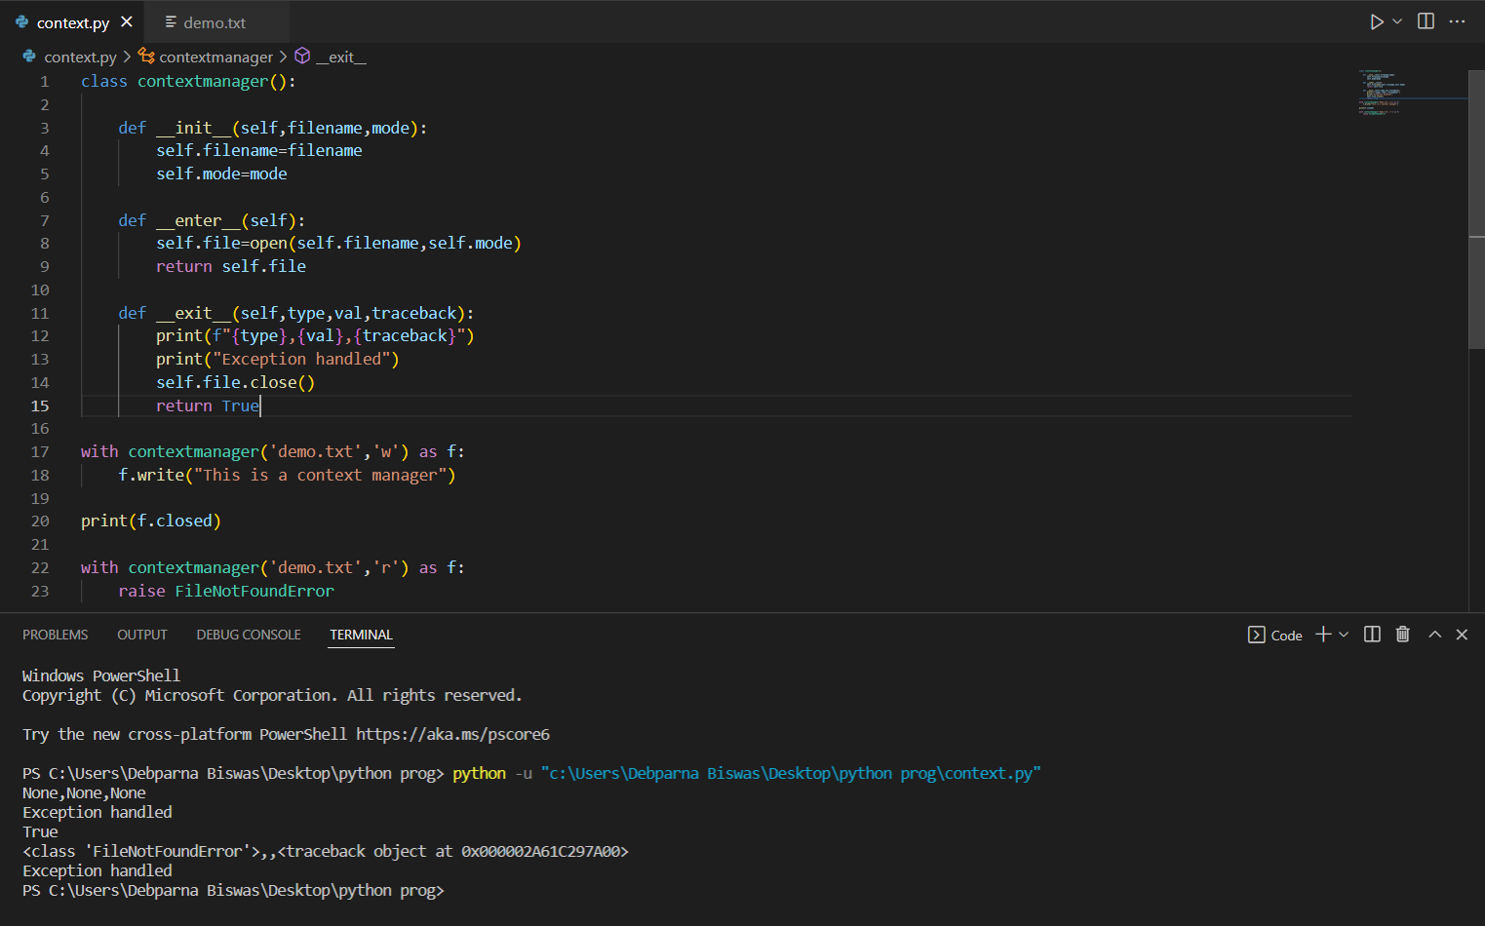
Handling Exception

Slide 8
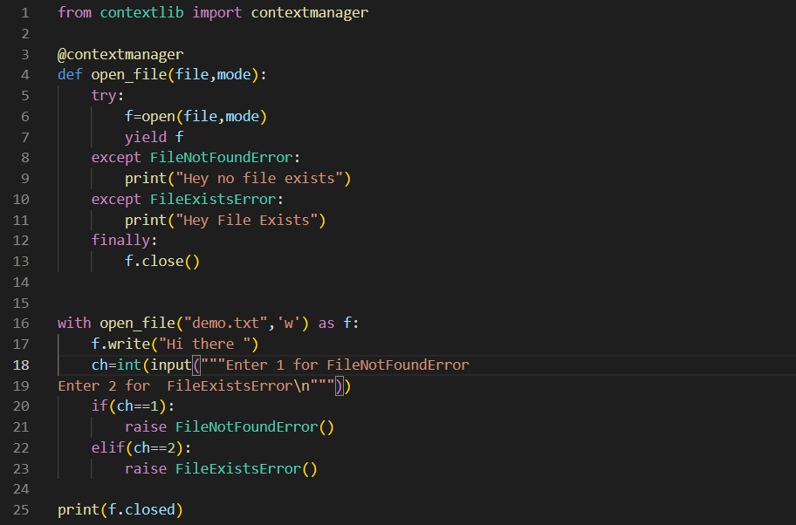
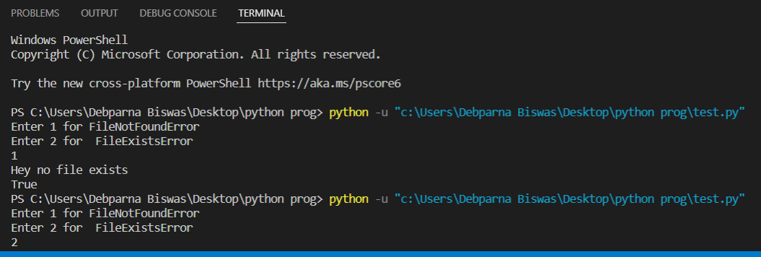
Another Method using contextlib

Slide 9
THE COLLECTION MODULE
There are normally four collection data types in python:-
List
Tuple
Sets
Dictionary
There is an in-built module in python called The Collection Module which helps us implement special types of data structures that increase the functionalities of the basic collection data types. The Collection Module includes the following:
Counter
OrderedDict
defaultdict
ChainMap
deque
namedtuple()
UserDict
UserList
UserString

Slide 10
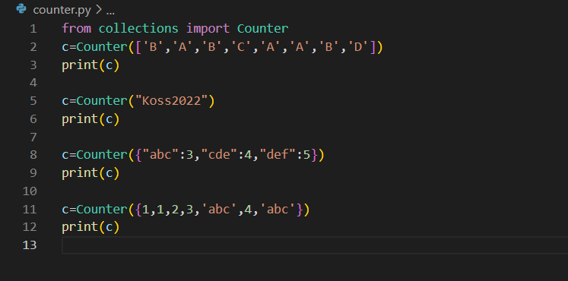
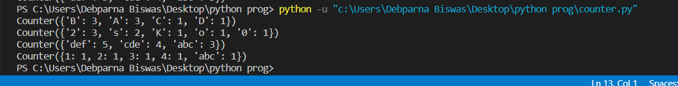
Counter

Slide 11
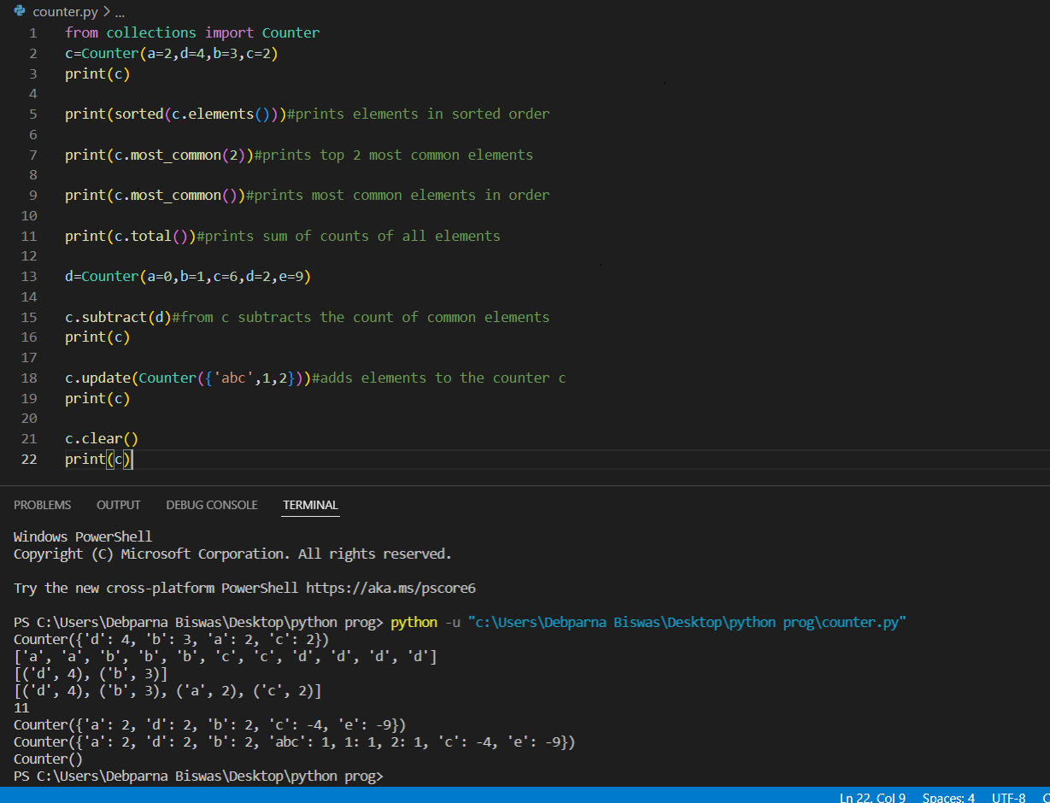

Slide 12
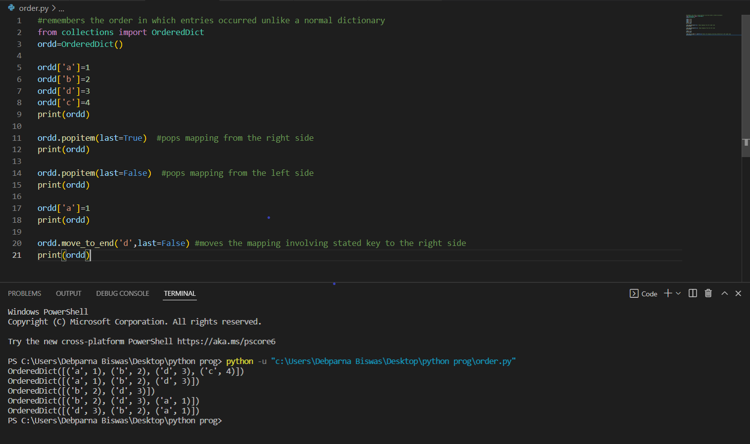
OrderedDict

Slide 13
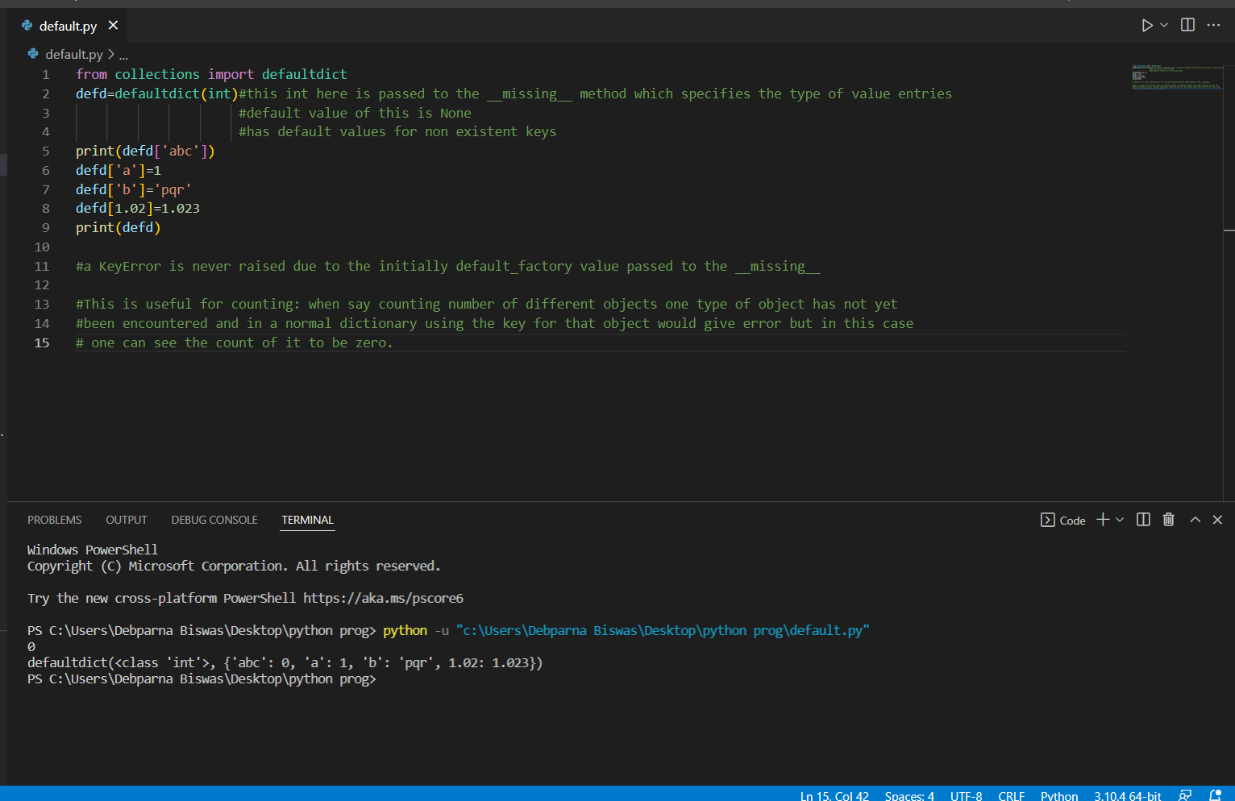
defaultdict

Slide 14
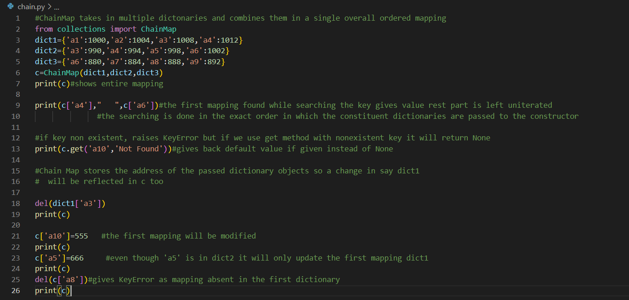
ChainMap

Slide 15
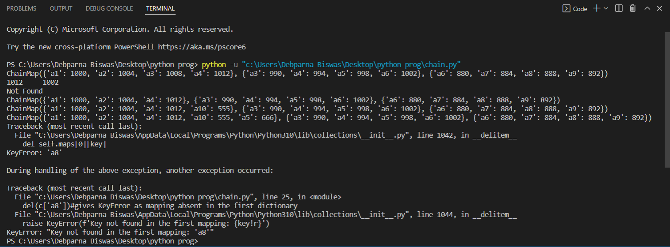

Slide 16
More ChainMap attributes
maps :- maps attribute shows the list format in which the mappings are actually returned and if we want to manage mappings properly we have to use maps.
parents:- returns a ChainMap with all the mappings except the first one(or we can say the first dictionary is excluded while returning the ChainMap via this attribute).
items:- returns all the accessible mappings.
pop:- returns and removes the key value pair if present in the first mapping and gives error if the key is absent in the first mapping. For removing from other mappings we have to use the maps attribute.
new_child:- A new mapping can be added in front of the present ChainMap.

Slide 17
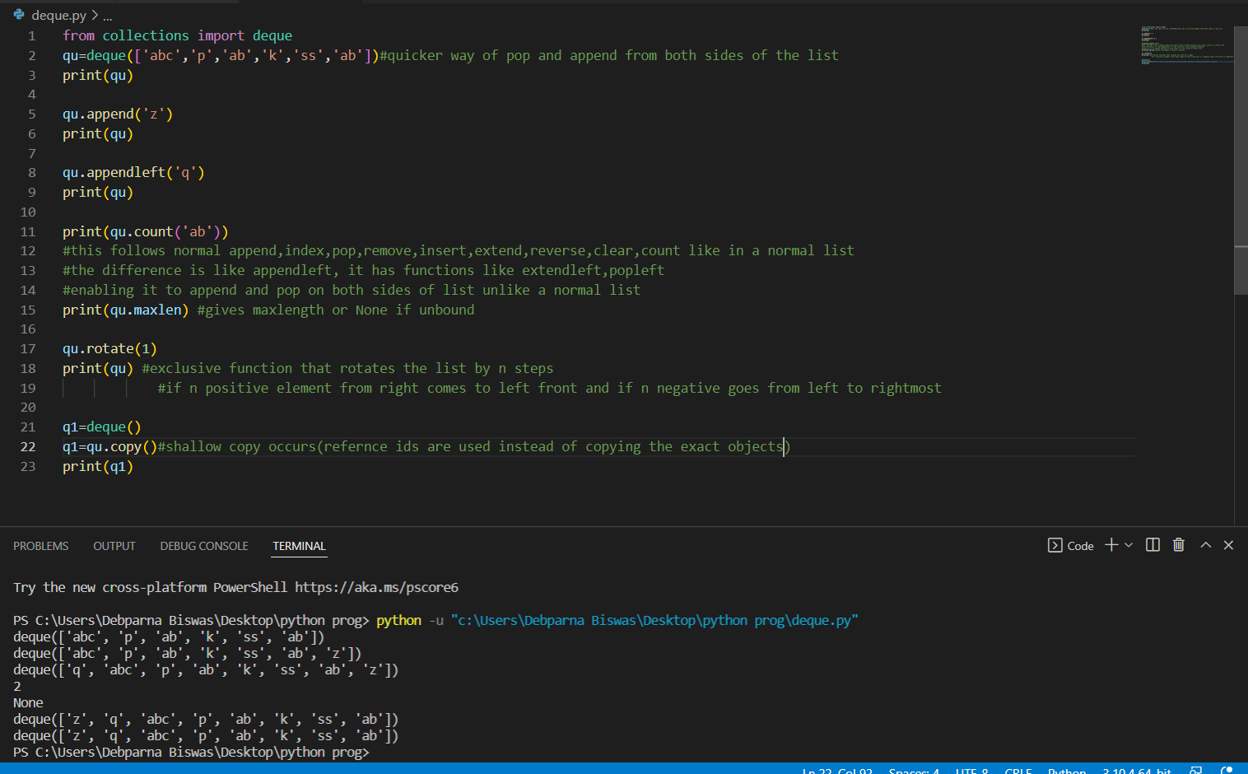
deque

Slide 18
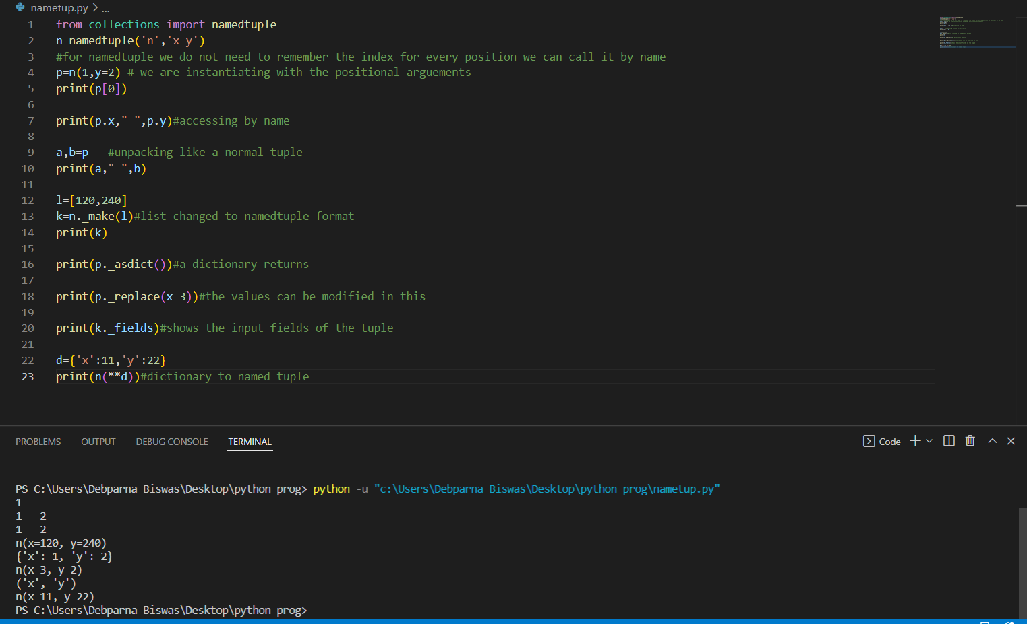
namedtuple()

Slide 19
UserDict, UserList and UserString
UserDict, UserList and UserString are containers that are imported from the Collection modules in the same fashion as the remaining types. These are basically used when we want to use a customized Dictionary, List or String respectively.
UserDict is used when we want to create our own custom dictionary.
UserList is used when we want to create our own custom list.
UserString is used when we want to create our own custom string.

Slide 20
THANK YOU

